Slide 1
Android Mobile Testing
Andrew Hopkins
Caio Balthazar
Luke Kennedy
Zac Reynolds

Slide 2
Testing in Android
Dependent on Mocking
Many system objects required
Thread Permissions and Security

Slide 3
Mocking
Use ActivityInstrumentationTestCase2 class to be able to interact with Activities
Context required by all Android Activities
Must be mocked to use any Android elements using MockContext class.

Slide 4
Threading causes Problems
Tests and Application Run on Different Threads
Android security prevents interference between threads
Testing requires specifying a Runnable object to execute tests within Android to get around application permissions

Slide 5
Android Threading Rules
Prevent Blocking the UI Thread
Avoid accessing Android UI toolkit from outside of UI Thread
Notes:
#2 This is the issue Zac was running into.

Slide 6
Fixing Threading Issues
Schedule the UI Thread using Built-in Methods
Asynchronous Methods
Explicit Threading
Notes:
Builtiin methods:
Activity.runOnUiThread(Runnable)
View.post(Runnable)
View.postDelayed(Runnable, long) //(long = time to scheduling)
Asynchronous methods
Four AsyncTask methods:
onPreExecute()
onProgressUpdate()
onPostExecute()
doInBackground()
only doInBackground is Asynchronous, others run on UI thread and can update the UI
Explicit threading
create a handler in the thread you are trying to access (UI thread) that will run what you want it to run and it can be accessed from another thread.

Slide 7
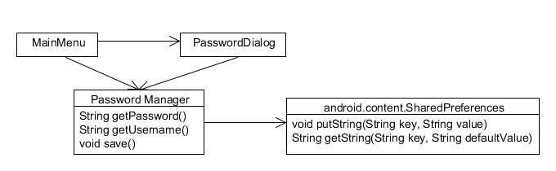
Old Untestable Crappy Stuff

Slide 8
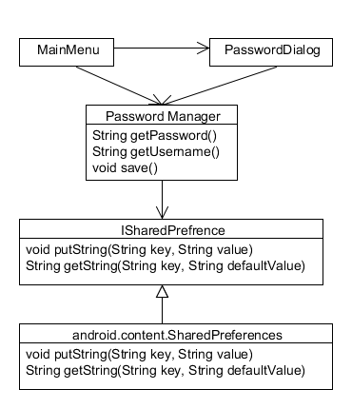
New Testable Not as Crappy Stuff

Slide 9
Example
@Before
public void setUp(){
pref = createMock(ISharedPreferences.class);
manager = new PasswordManager(pref);
}
@Test
public void testLoadBlankCrediantials(){
expect(pref.getString(PasswordManager.USERNAME, "")).andReturn("");
expect(pref.getString(PasswordManager.PASSWORD, "")).andReturn("");
replay(pref);
assertEquals("", manager.getUsername());
assertEquals("", manager.getPassword());
}

Slide 10

Demo Stuff

